Slide 1
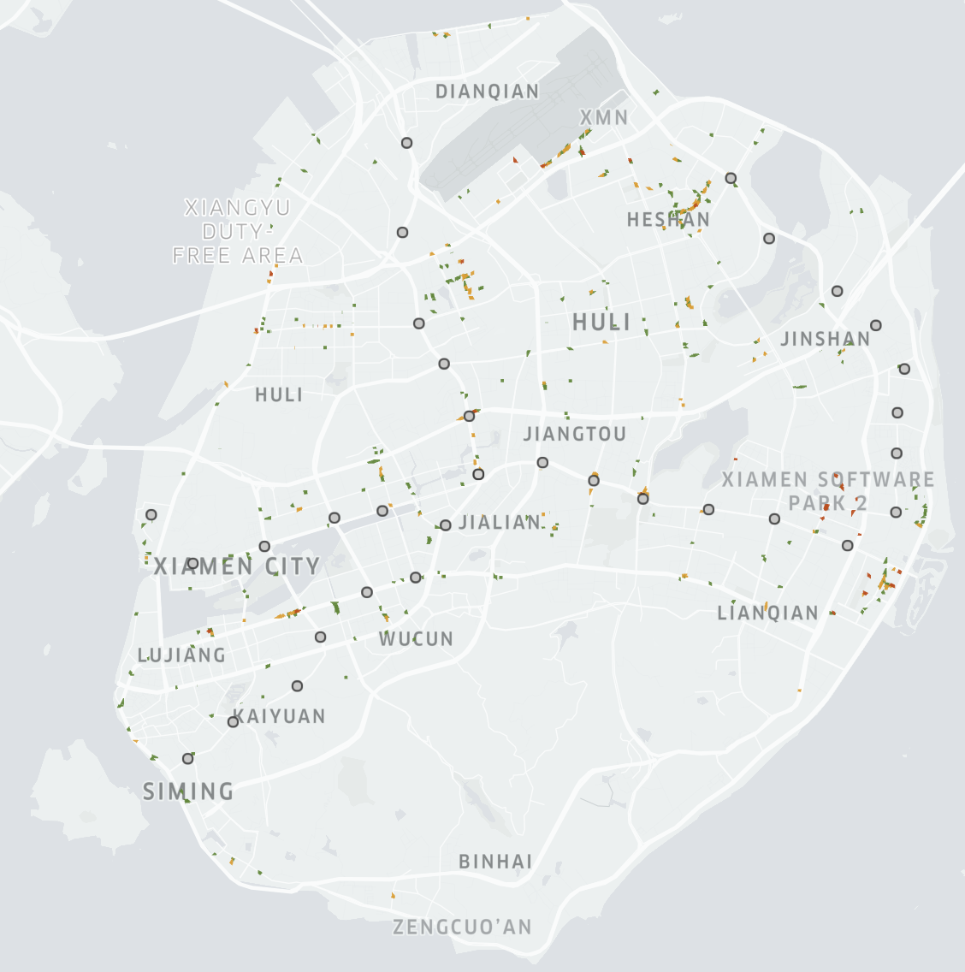
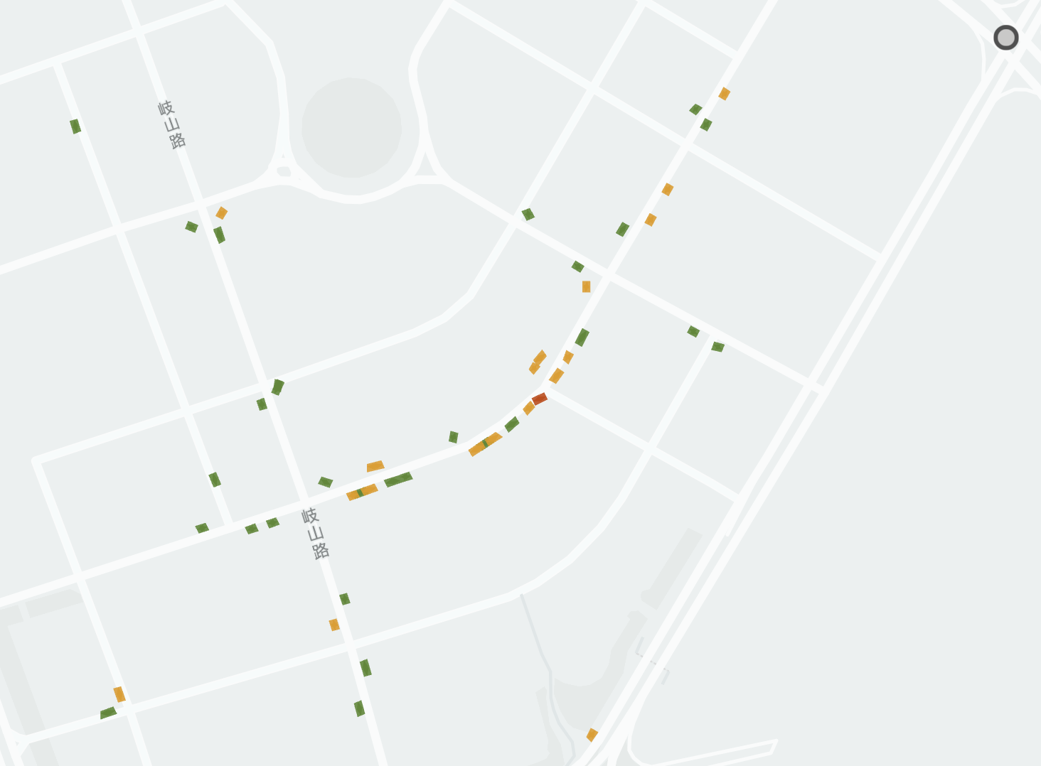
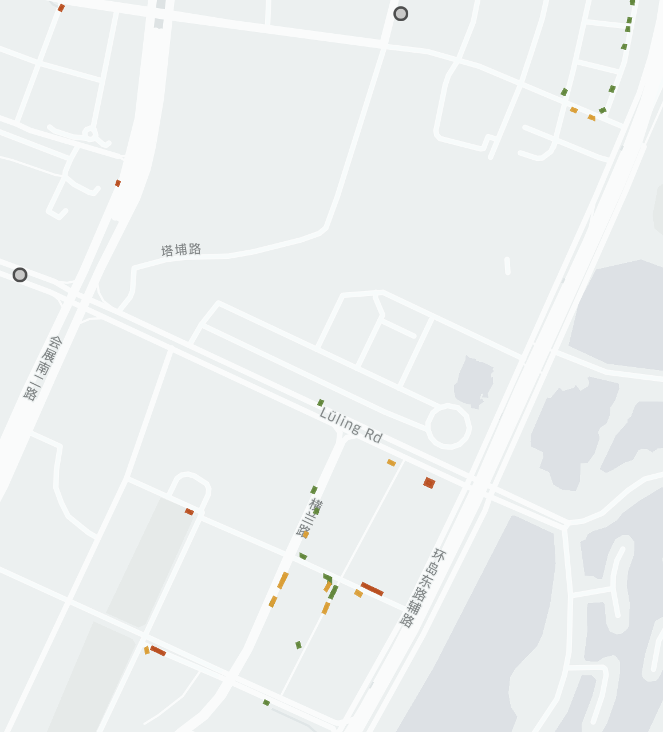

Wuyuanwan Station
Hecuo Station
Software Park II Station
Subway station
High_overloading
Semi_overloading
Low_overloading

Slide 2
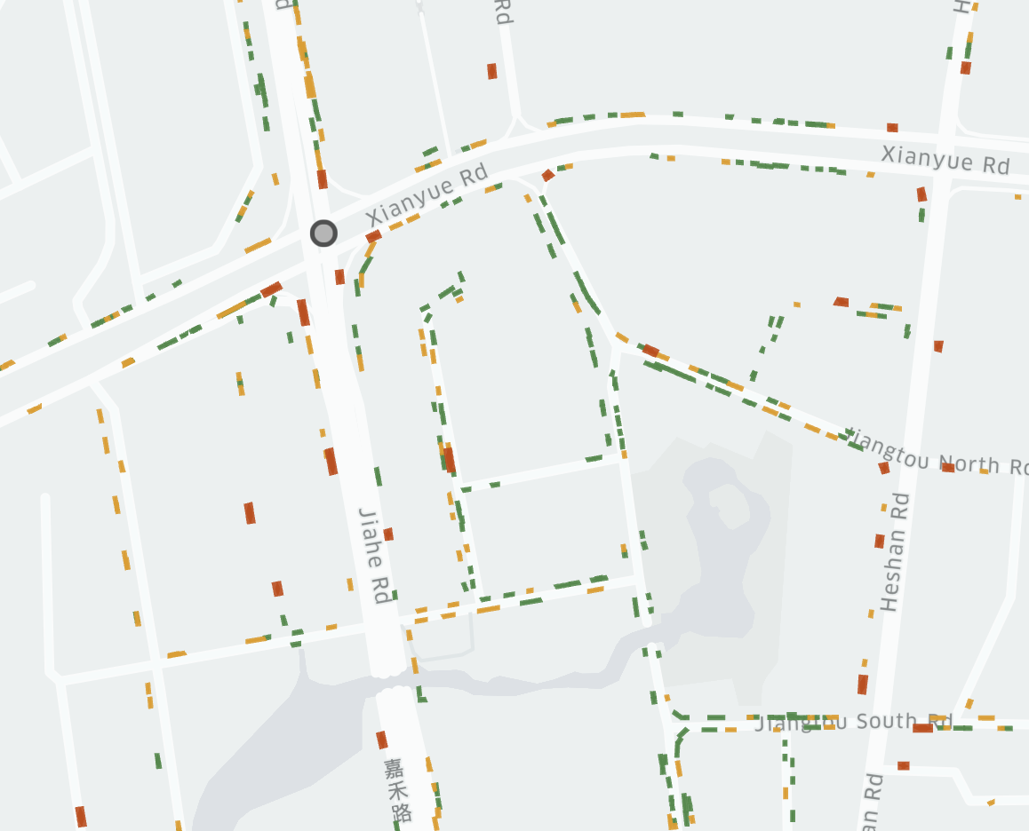
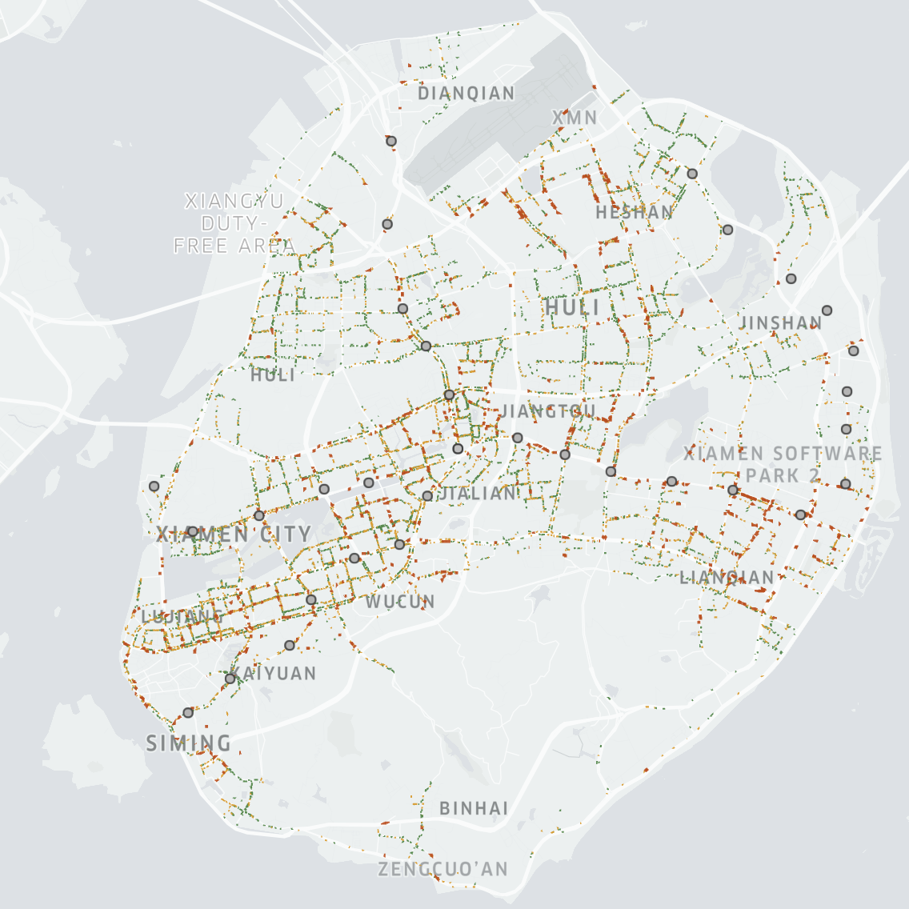
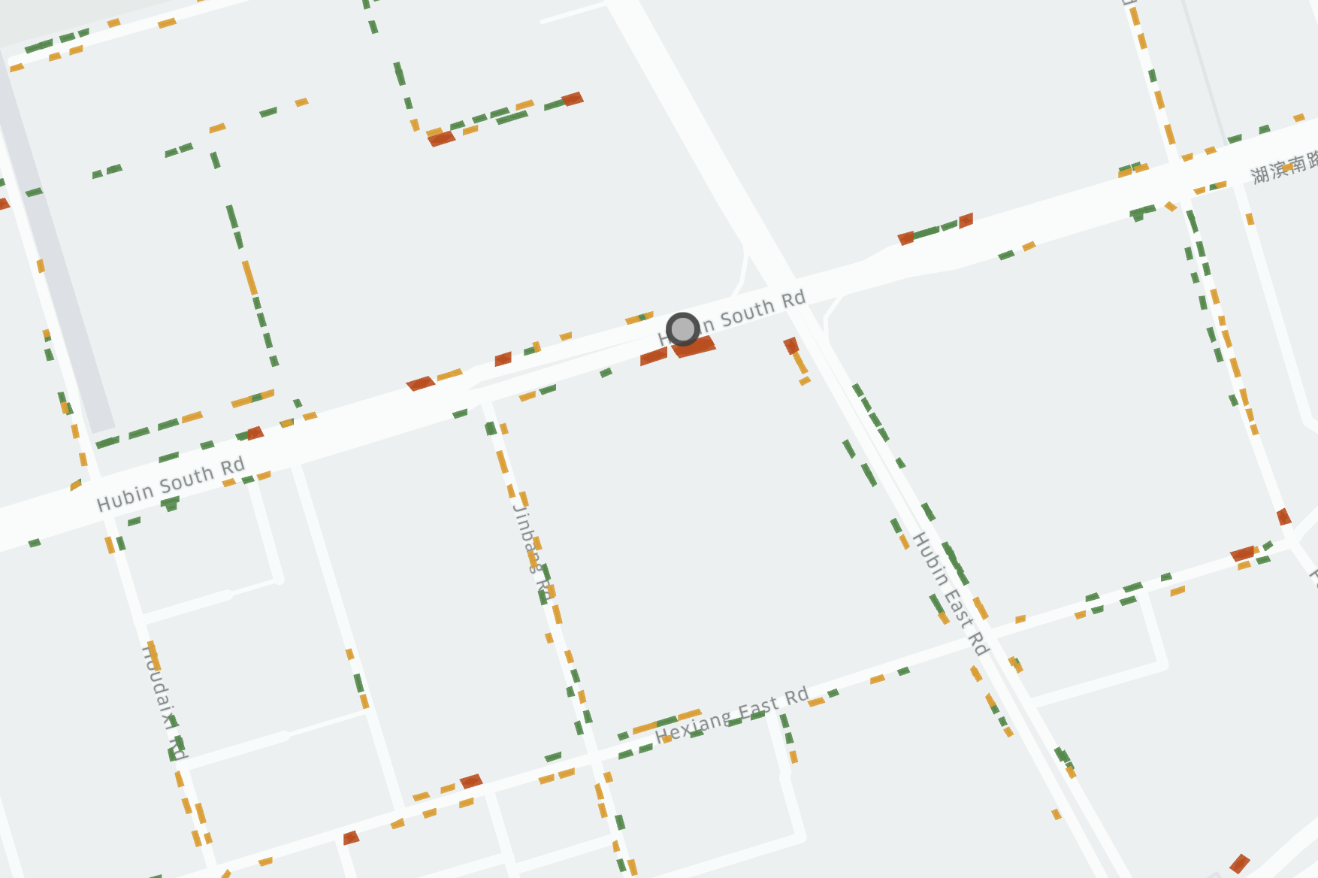
Wushipu Station
Hubin South Rd Station
Subway station
High_underloading
Semi_underloading
Low_underloading

